Slide 1
Vous voulez du vin?
Does the use of foreign language advertising in wine increase customer’s purchase likelihood?
Presentation for W241 Project
Rory Liu, Charlotte Swavola, Sharad Varadarajan

Slide 2
BACKGROUND AND motivation

Slide 3
Experimental Design
Multi-factorial Design: 3 x 2 x 2
Survey Flow
Demographics
(language, income, gender)
 |  | Page Language
 |  | English |  | French |  | German
 |  | Flavor Profile Description
 |  | Long |  |  | Short
Country of Origin | US | 1 | 2 | 3 | 4 | 5 | 6
 | France | 7 | 8 | 9 | 10 | 11 | 12
Wine Habits
(drink frequency, preference, purchase frequency)
Treatment (Randomized group 1-12 shown different simulated purchasing page)
Guess the cost of shown wine
Would you consider purchasing at 50? 35? 25?
Baseline (for test group only)
Guess the cost of a gallon of milk
Response gathering: Qualtrics survey + Mechanical Turk
Pilot study done with 100 respondent to understand feasibility and potential bugs
Sample size: 1200 in main survey + 600 in follow-up validation study

Slide 4
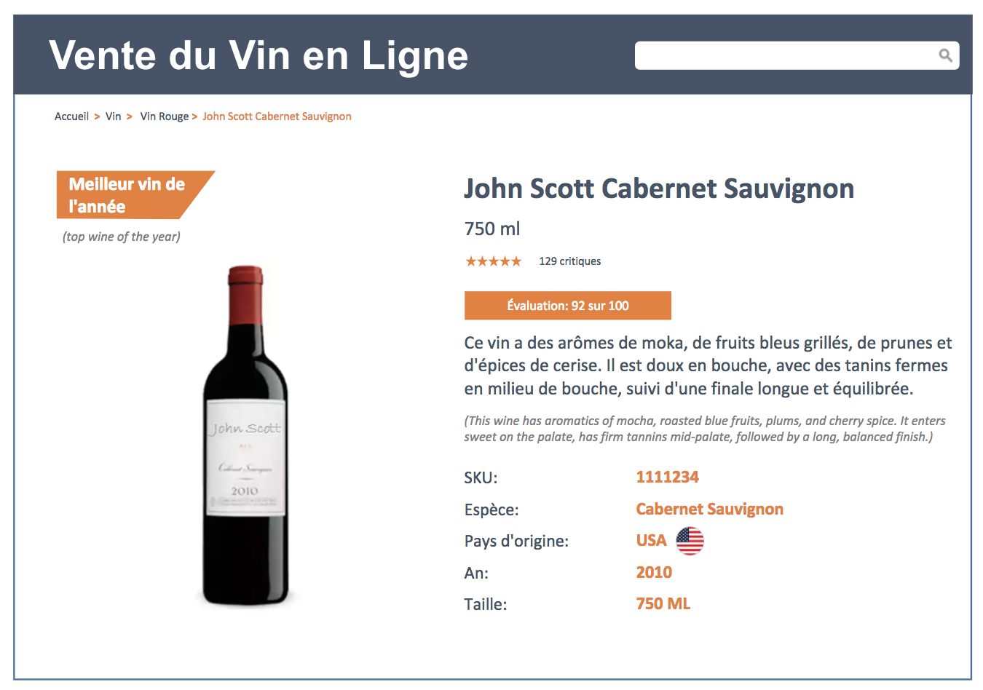
For reference: our SIMULATED WINE PAGE

Slide 5
Data processing AND CHECKS
Cleaning (dups, etc.)
Covariate balance check

Slide 6
findings

